Slide 1
Парикмахер в STEP7
Siemens

Slide 2
FUNCTION_BLOCK ENVR
VAR_output
ist:BOOL;
END_VAR
VAR
stat:INT;
END_VAR
stat := (stat+12888)*(17777+stat);
ist := stat>30000;
END_FUNCTION_BLOCK

Slide 3
FUNCTION_BLOCK BARBER
VAR_INPUT
aktivate : BOOL;
end_var
VAR_TEMP
TTIME:DT;
rv:INT;
i:INT;
END_VAR
VAR
AKTIV : BOOL;
START_TIME:TOD;
END_VAR
CONST
SERVICE_TIME:=t#3s;
END_CONST

Slide 4
rv := READ_CLK(CDT := TTIME);
IF aktivate THEN AKTIV:=true; start_time := DT_TOD(IN := TTIME); END_IF;
IF aktiv AND (DT_TOD(IN := TTIME)-START_TIME>SERVICE_TIME)
THEN AKTIV :=false; FOR i := 1 TO 3 DO
IF CLIENT_INST.SEAT[i] THEN AKTIV:=true;
start_time := DT_TOD(IN := TTIME); CLIENT_INST.SEAT[i]:=false; EXIT; END_IF; END_FOR;
END_IF;
END_FUNCTION_BLOCK

Slide 5
DATA_BLOCK BARBER_INST BARBER
BEGIN
END_DATA_BLOCK
DATA_BLOCK ENVR_INST ENVR
BEGIN
END_DATA_BLOCK

Slide 6
ORGANIZATION_BLOCK OB35
VAR_TEMP
info : ARRAY[0..19] OF BYTE;
END_VAR
ENVR.ENVR_INST(); q0.0 := ENVR_INST.ist;
IF ENVR_INST.ist THEN CLIENT.CLIENT_INST(); END_IF;
BARBER.BARBER_INST(Aktivate:=false);
END_ORGANIZATION_BLOCK

Slide 7
FUNCTION_BLOCK CLIENT
VAR_TEMP
i:INT;
END_VAR
VAR
SEAT: ARRAY [1..3] OF BOOL;
END_VAR
IF NOT BARBER_INST.AKTIV THEN BARBER.BARBER_INST(Aktivate:=true);
ELSE FOR i := 1 TO 3 DO IF NOT SEAT[i] THEN SEAT[i] := true; EXIT; END_IF; END_FOR; END_IF;
END_FUNCTION_BLOCK
DATA_BLOCK CLIENT_INST CLIENT
BEGIN
END_DATA_BLOCK

Slide 8
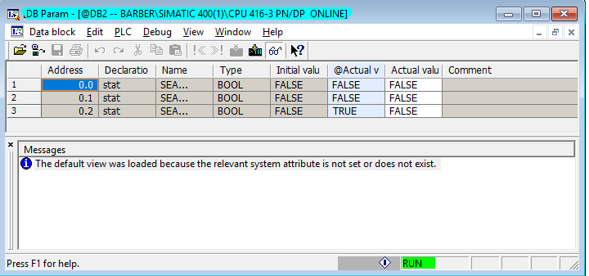
Мониторинг блока данных

Slide 9
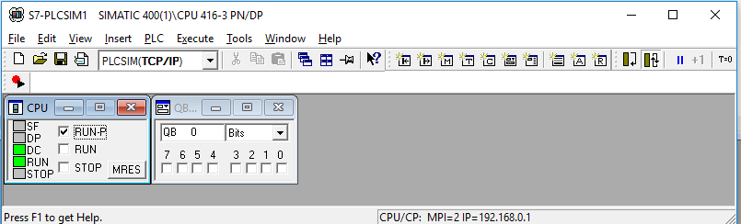
Мониторинг в имитаторе контроллера

